Slide 1

Foraging and movement
Shruthi Sukumar

Slide 2

What would you do?
Imagine reaching towards a pencil to write down a research idea?
Remember, moments earlier your abstract was accepted. Now how fast would you reach?
What if your abstract had been rejected? How would that impact your reach speed?
Notes:
Try to think of some other example

Slide 3
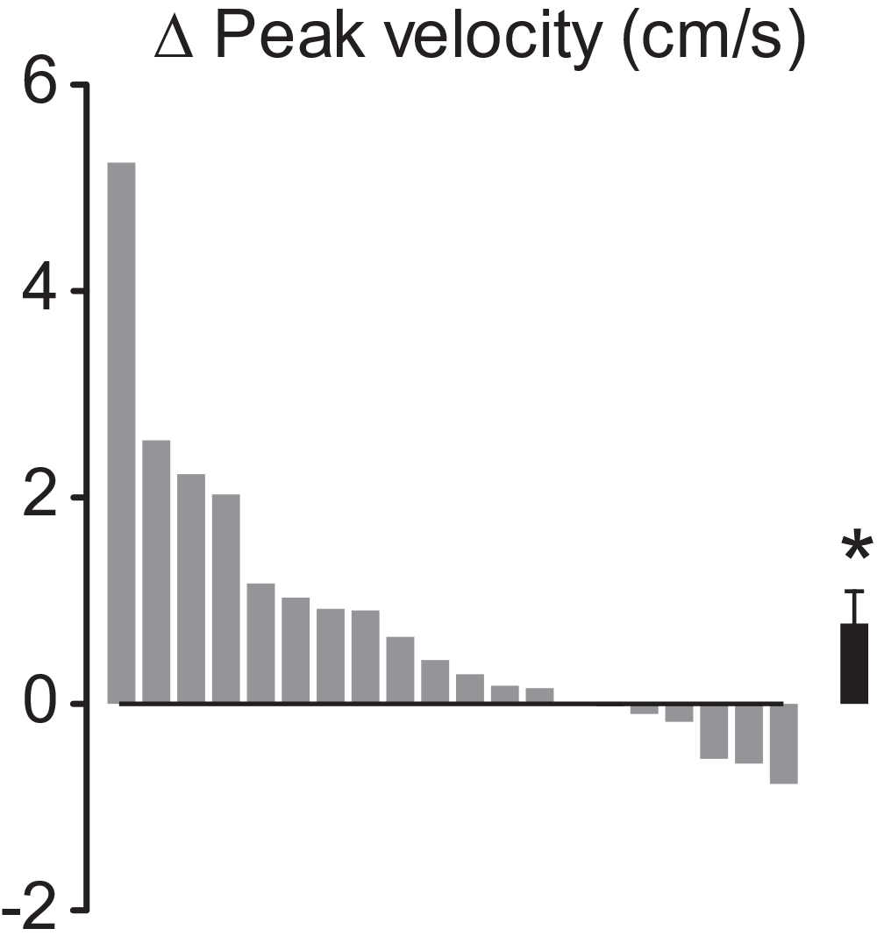
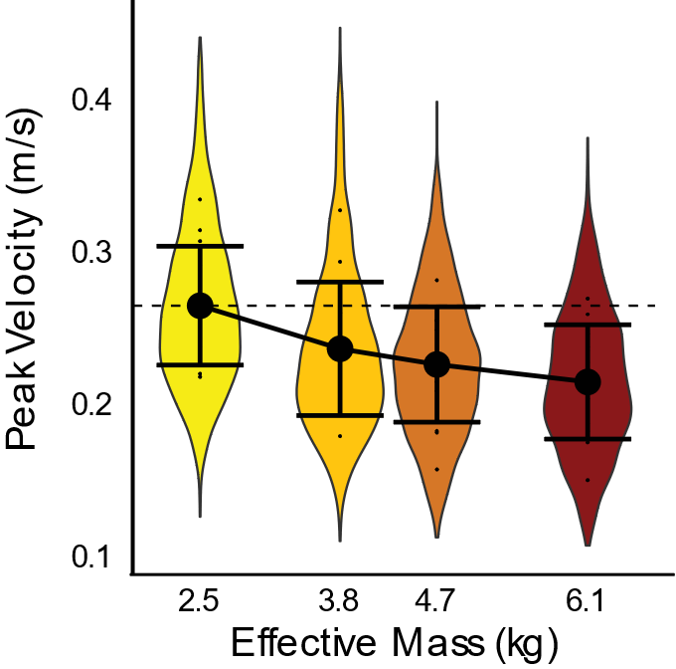
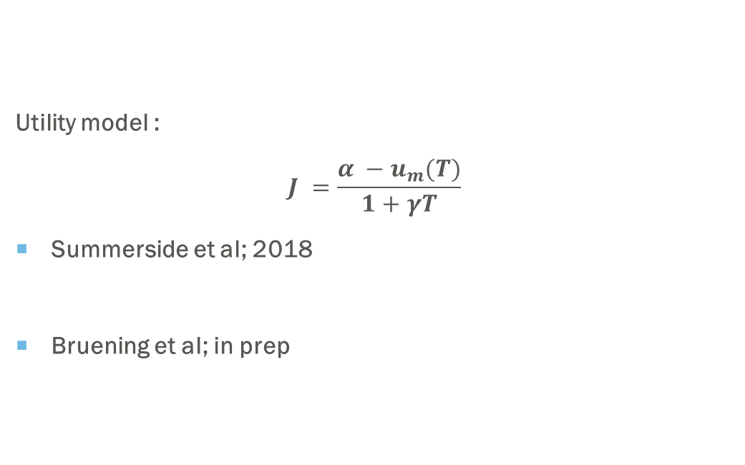
Movement vigor and its influencers
Utility model :
$$J =\frac{α −u_{m}(T)}{1+γT}$$
Summerside et al; 2018
Bruening et al; in prep
Notes:
Combining ‘how’ we make reaches to ‘why’ we make reaches (Shadmehr, Huang and Ahmed).

Slide 4
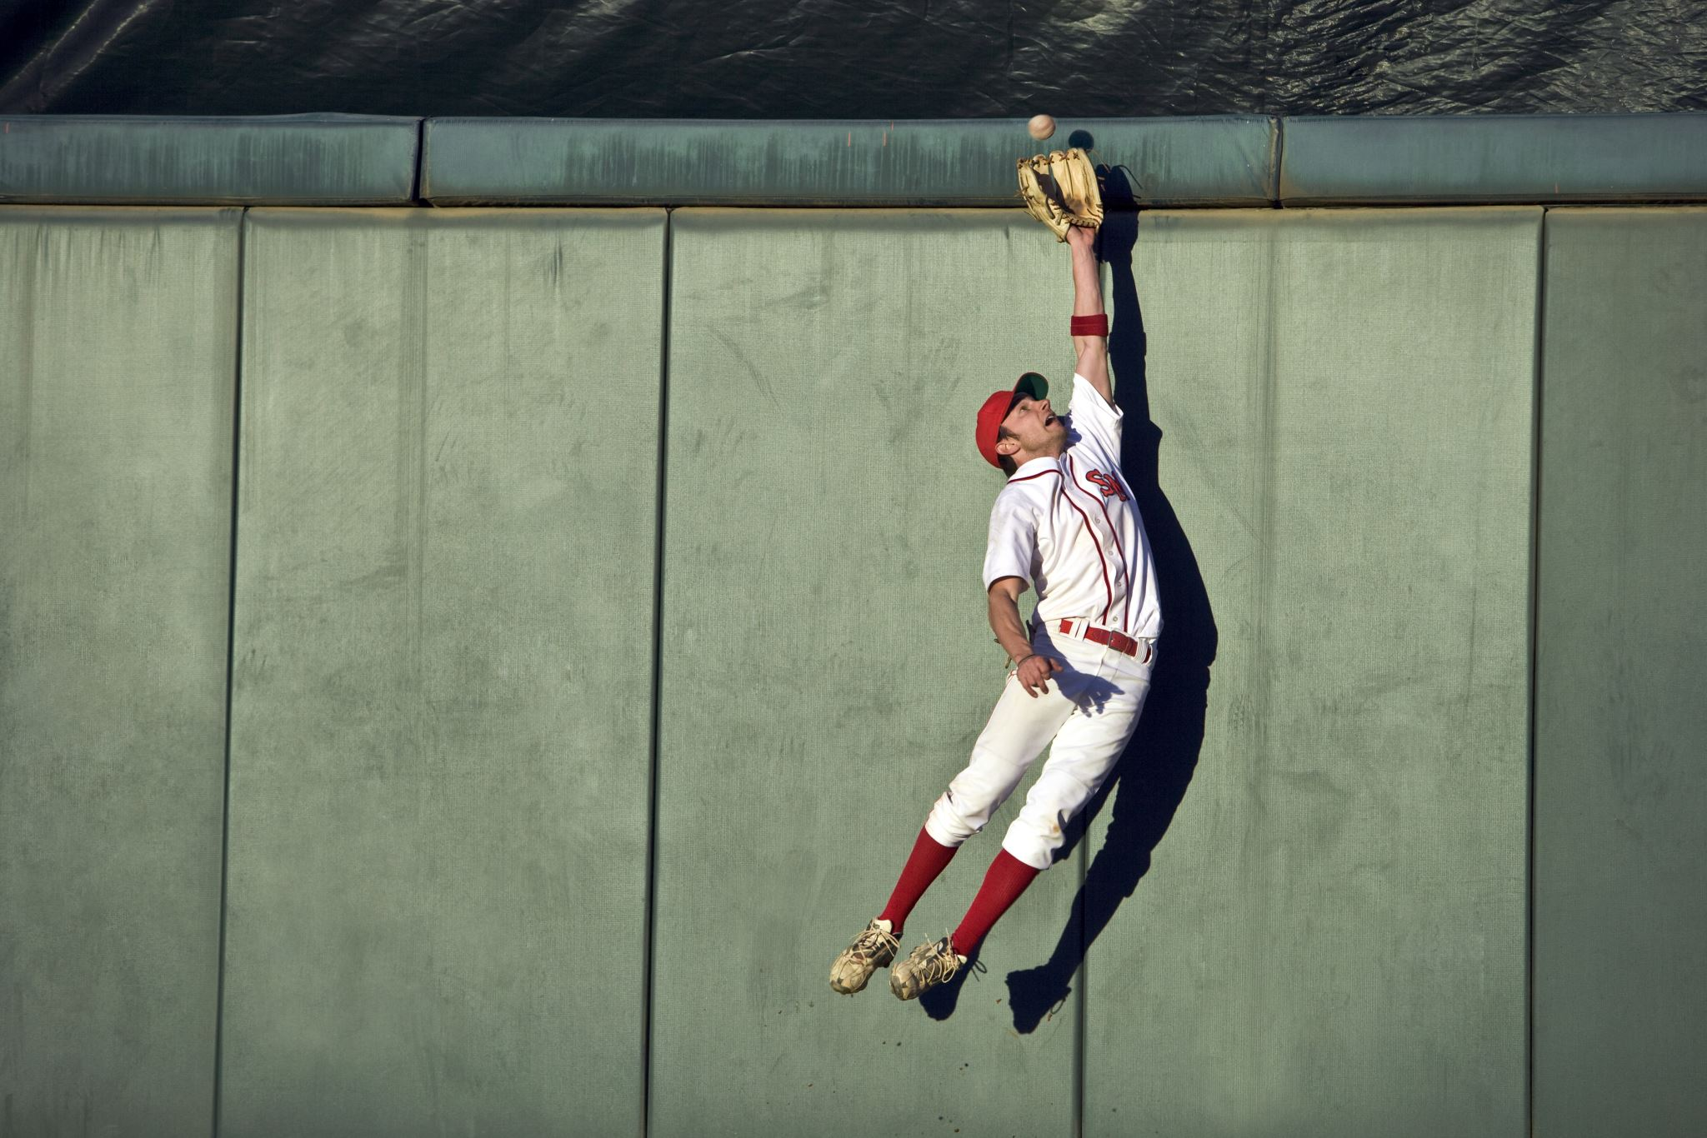
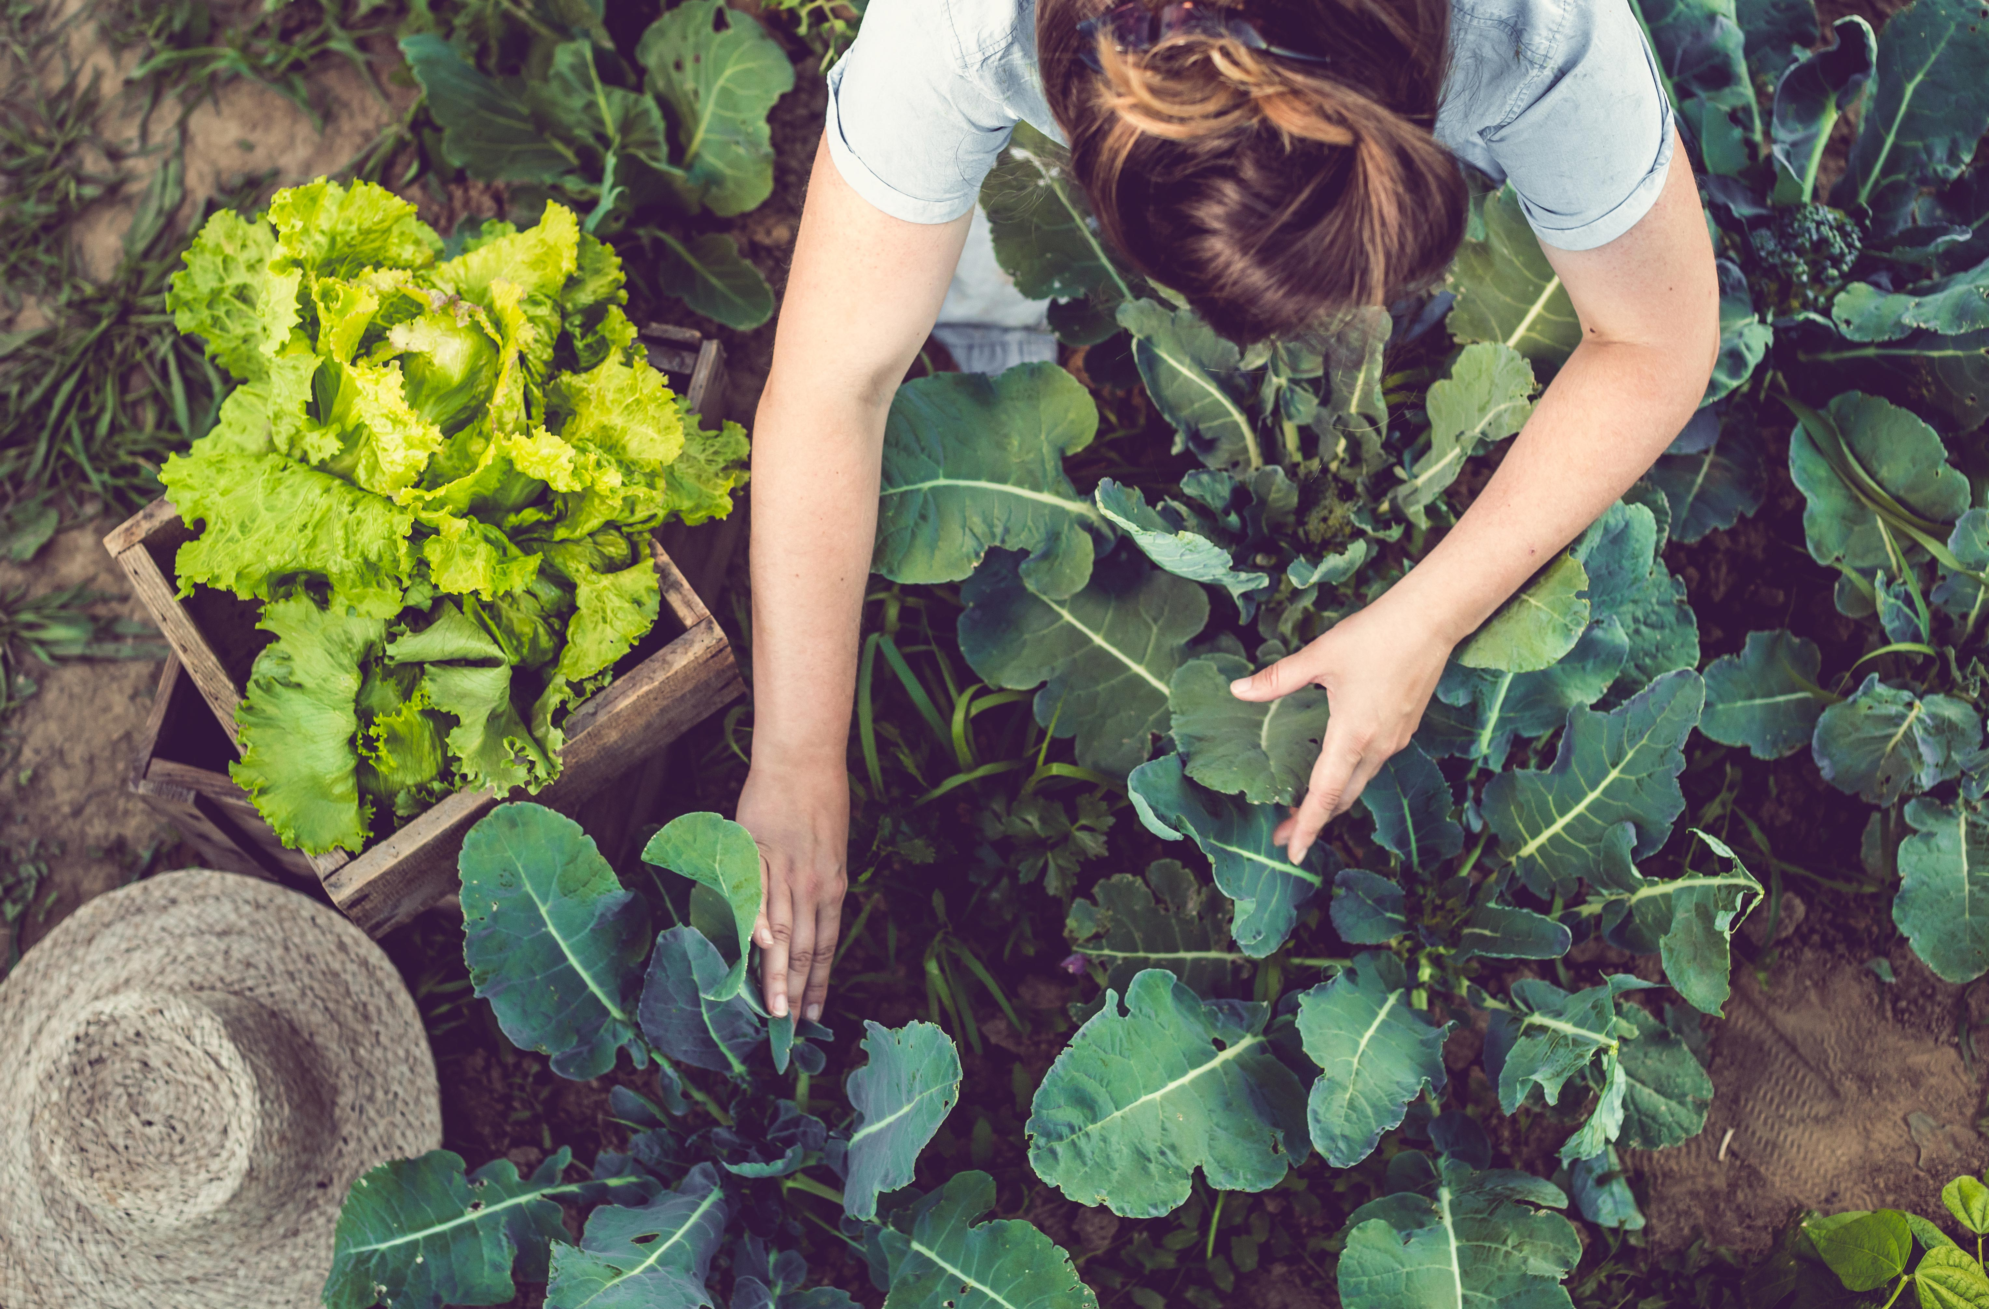
Why do we make reaches anyway?
Notes:
In the real world, reaches are actions that we make intermittently among many others.
Do the experiences and outcomes of those actions affect our reach speed?

Slide 5
Research question
Do the experiences and outcomes of past actions affect reach vigor?

Slide 6
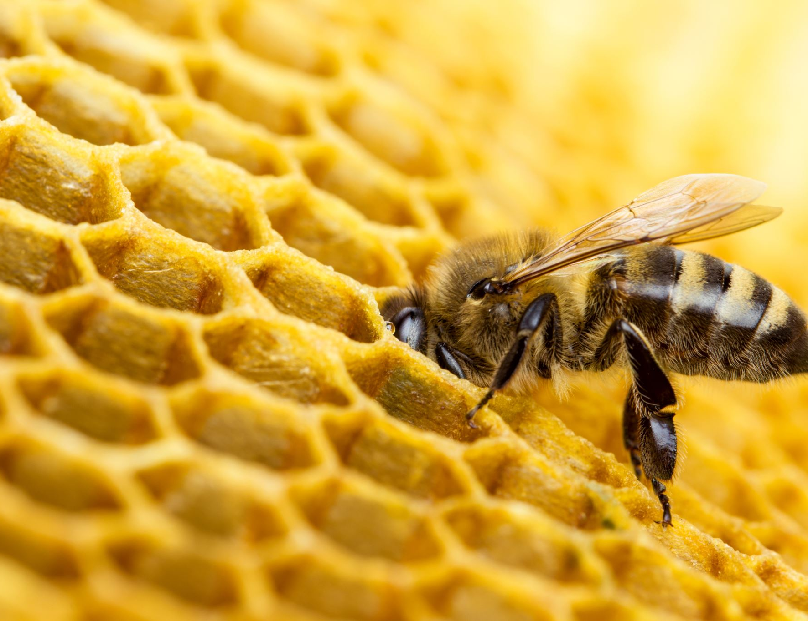
The classical marginal value theorem (mvt)
“ The predator must leave a patch it is presently in when the marginal capture rate in the patch drops to the average capture rate for the habitat ”
- Eric Charnov 1976

Slide 7
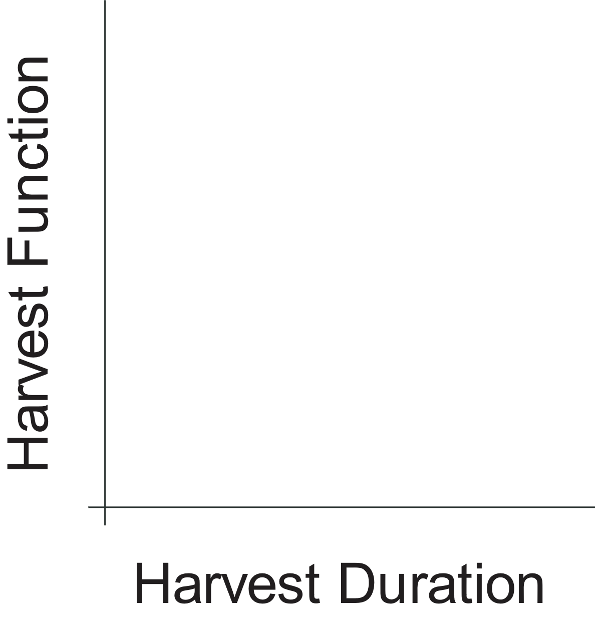
The classical marginal value theorem (mvt)

Slide 8
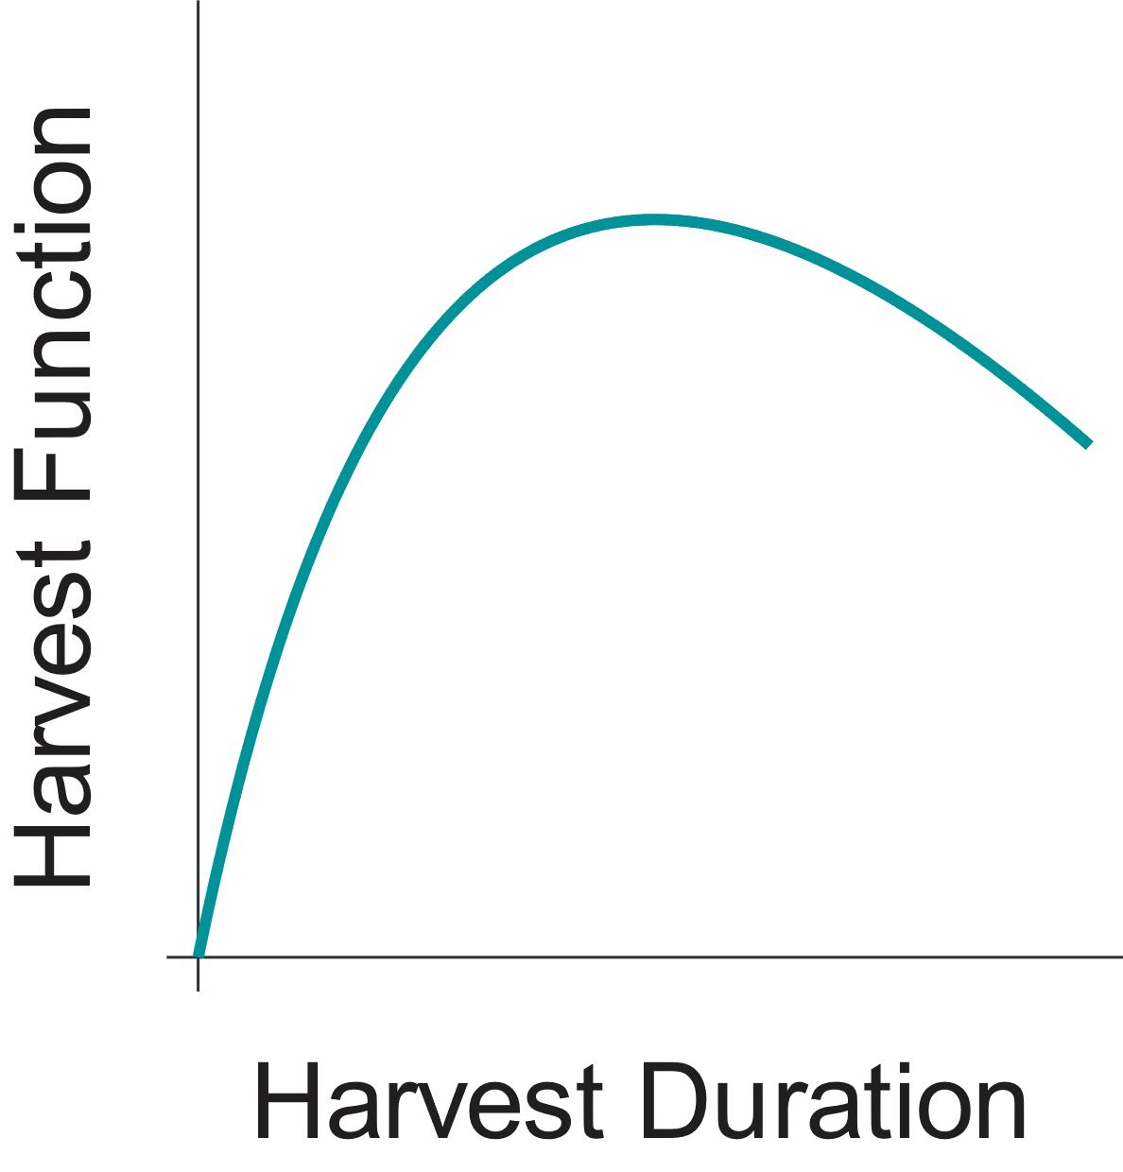
The classical marginal value theorem (mvt)

Slide 9
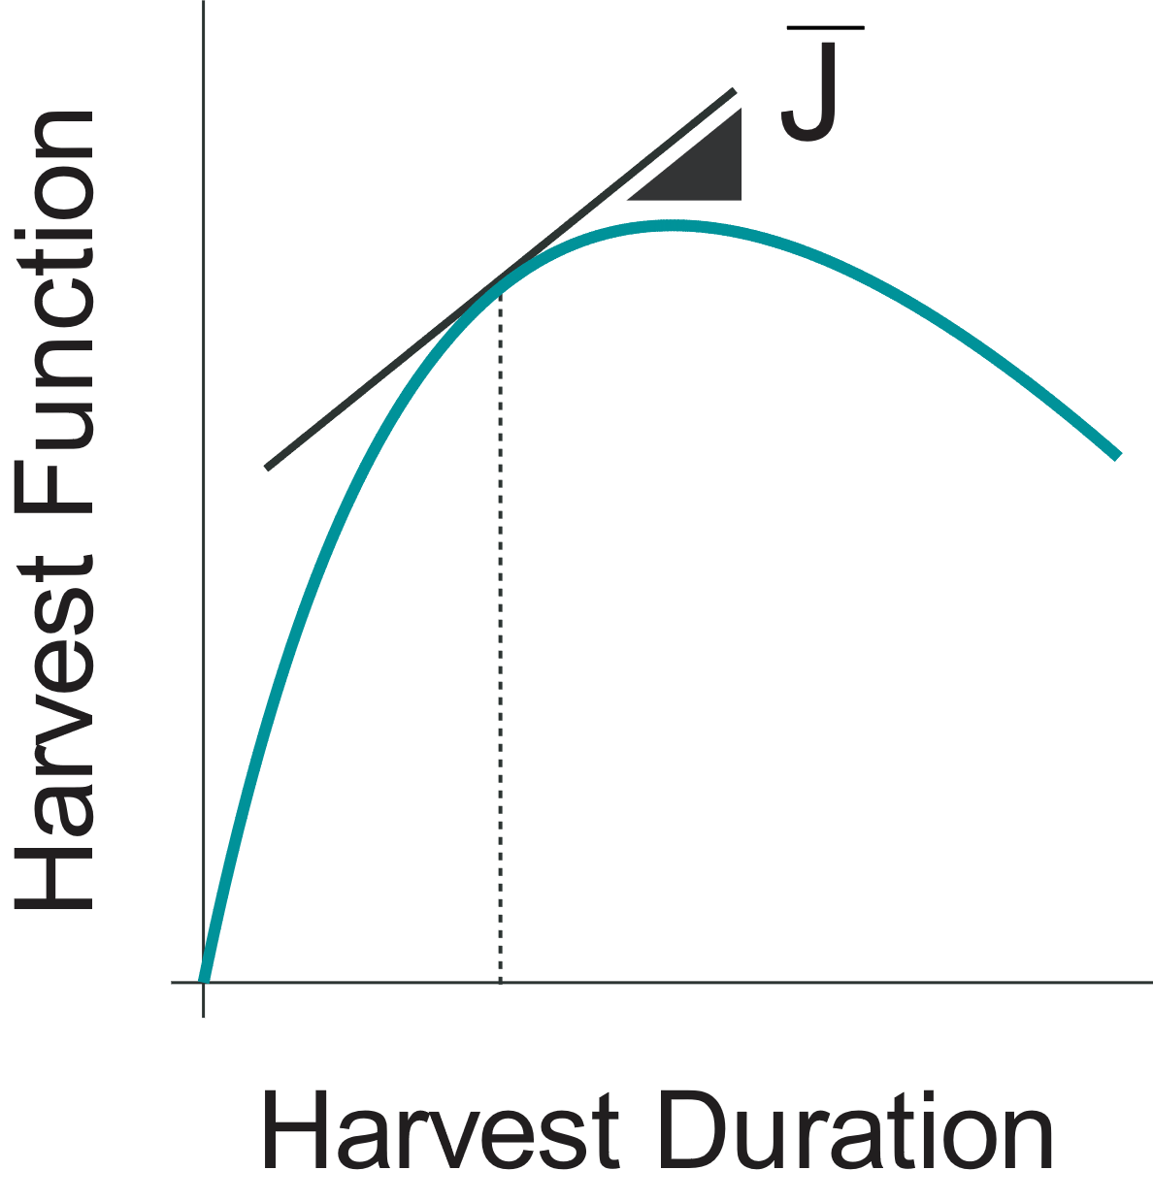
The classical marginal value theorem (mvt)

Slide 10
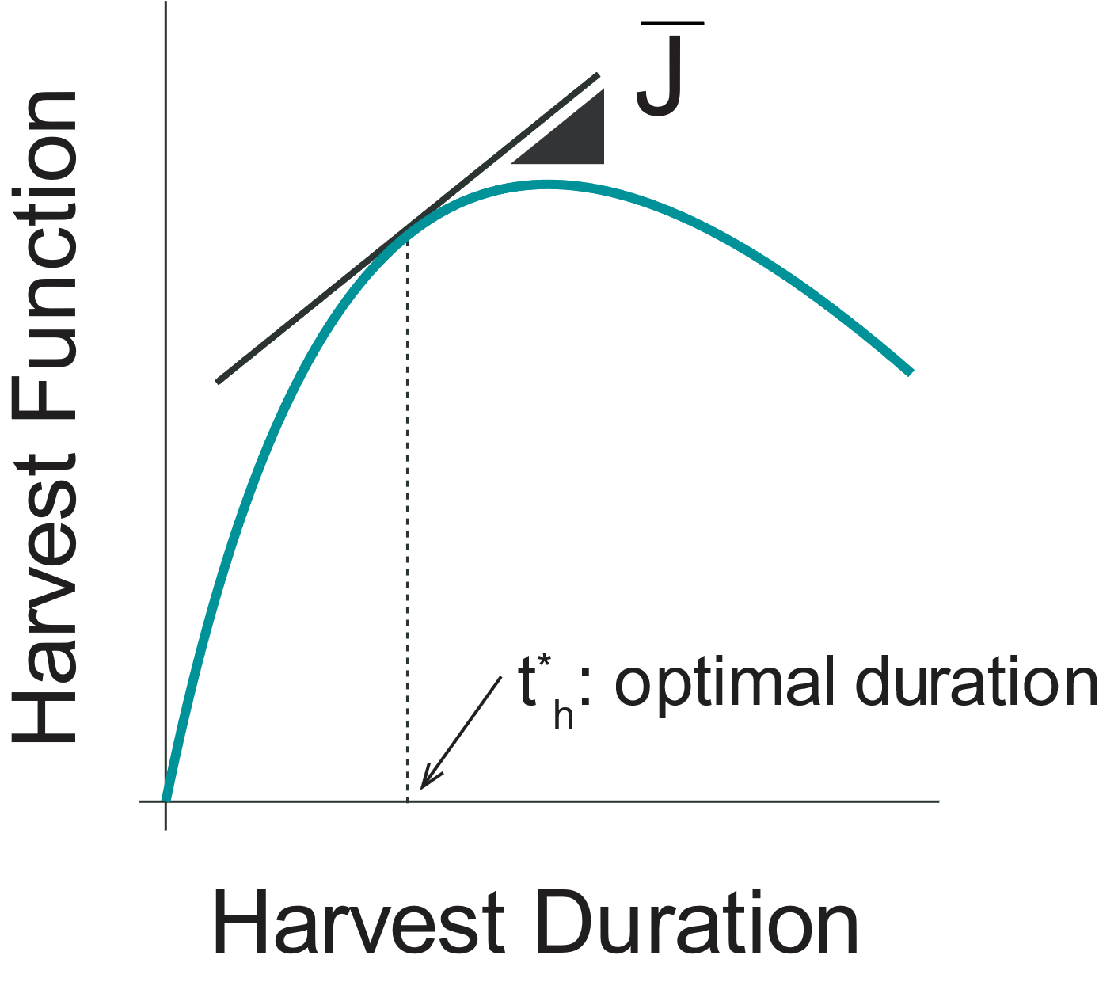
The classical marginal value theorem (mvt)

Slide 11
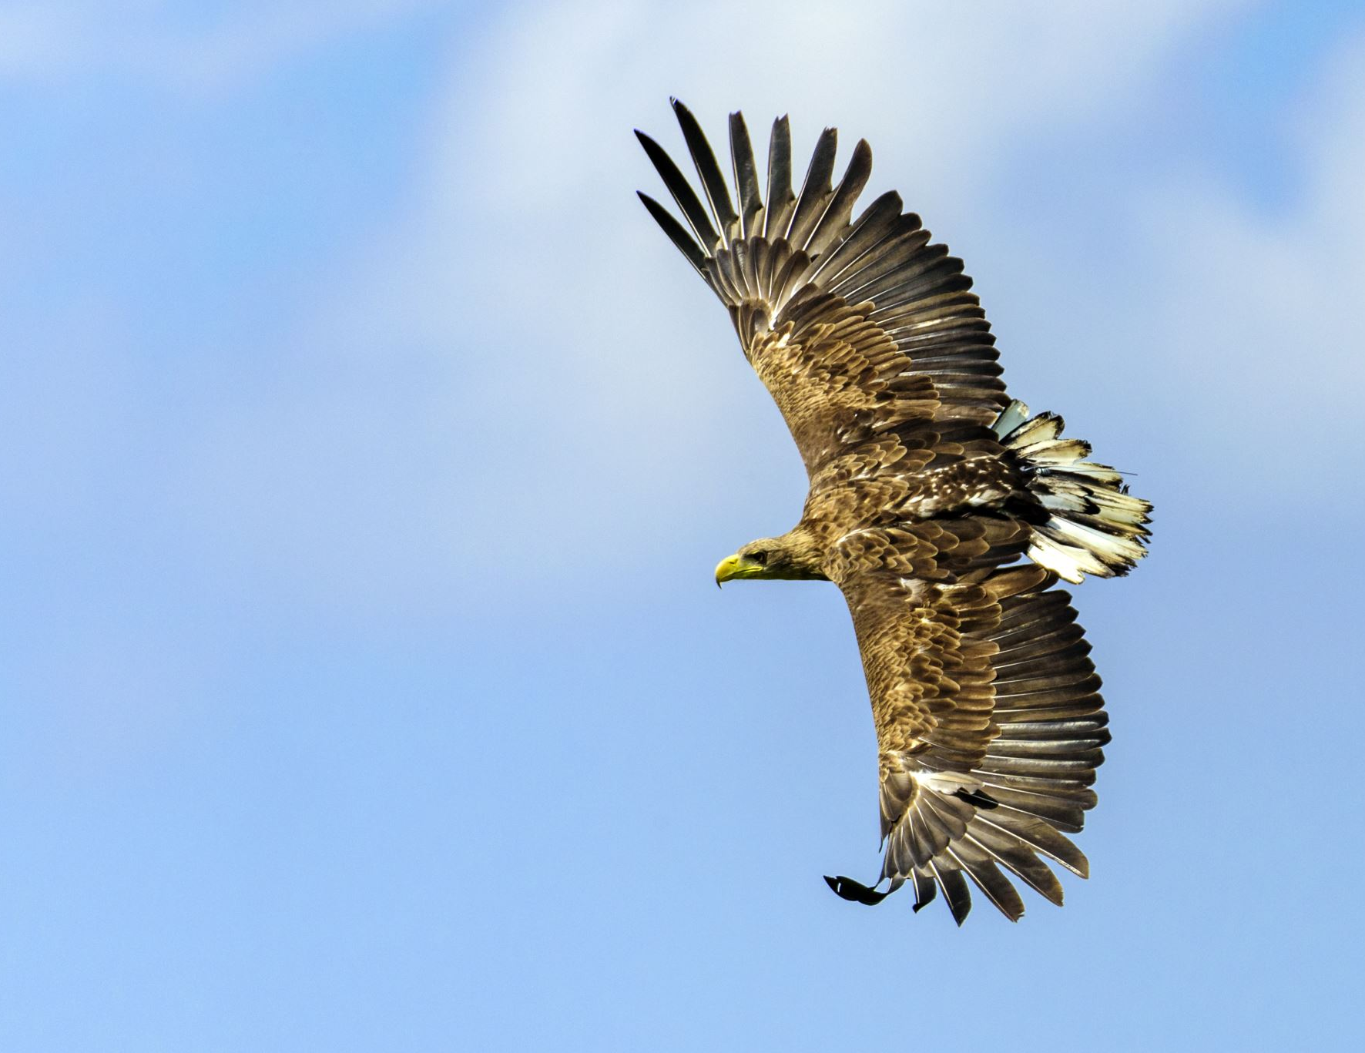
Generalized Mvt
“[…] how does it determine the speed of the ensuing movement?”
- Yoon et al 2018

Slide 12
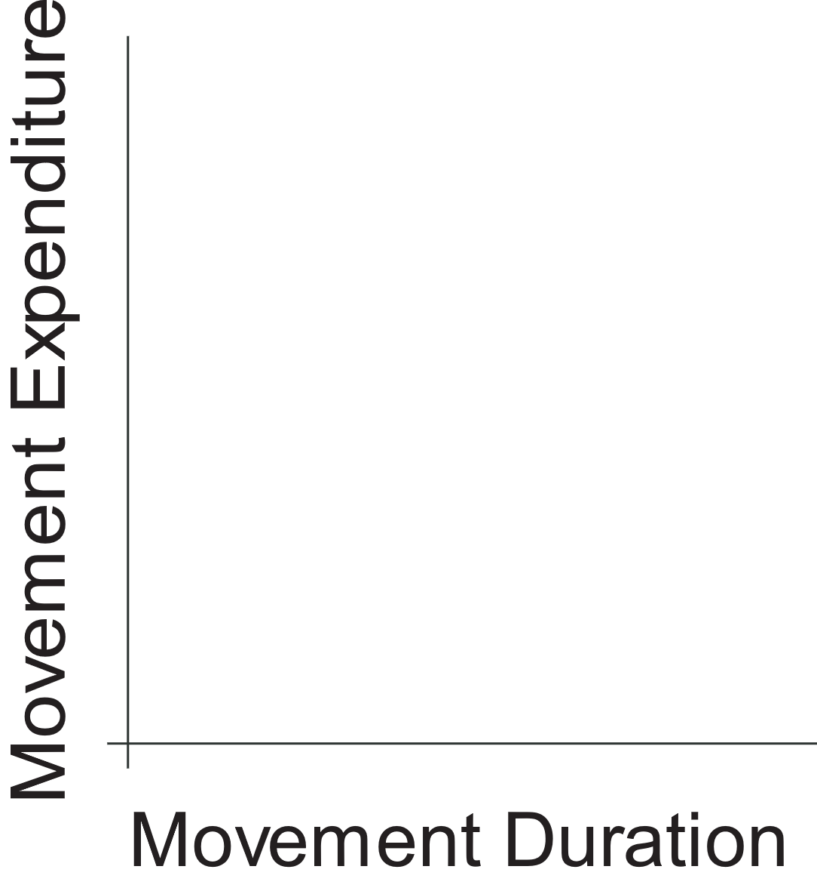
Generalized Mvt

Slide 13
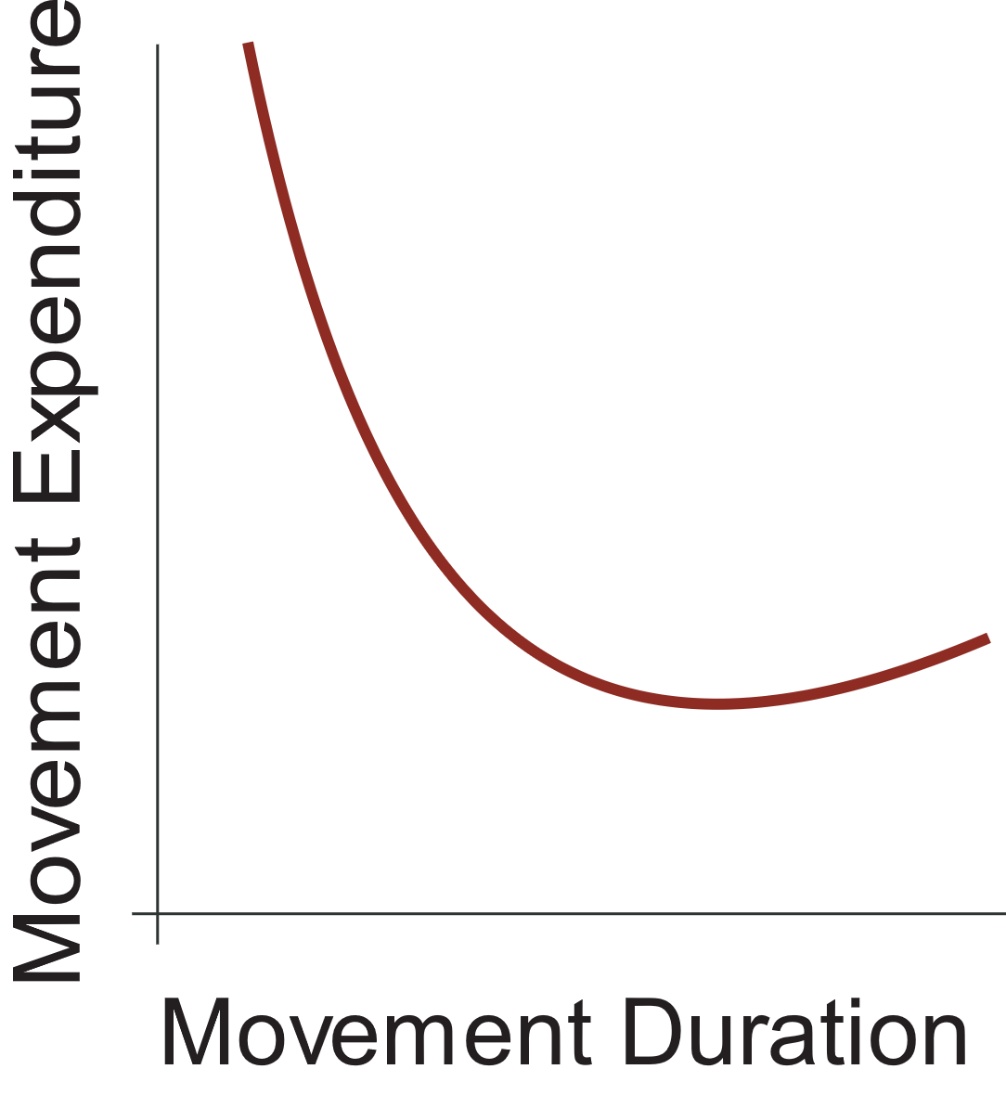
Generalized Mvt

Slide 14
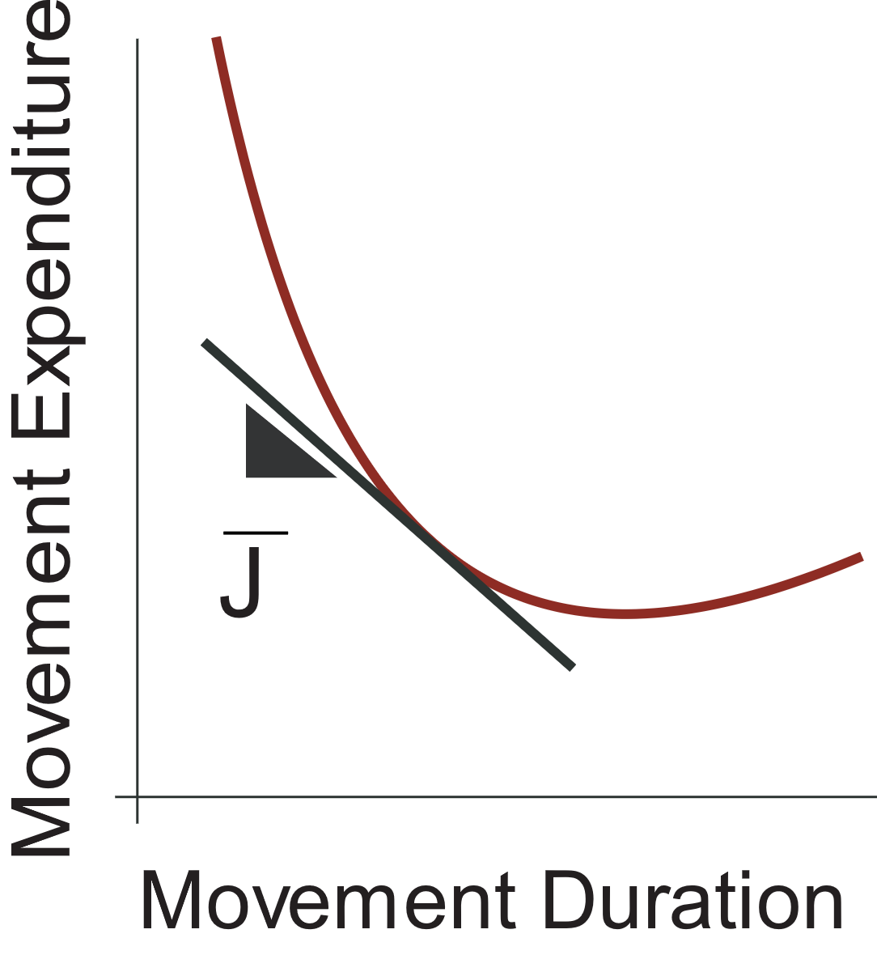
Generalized Mvt

Slide 15
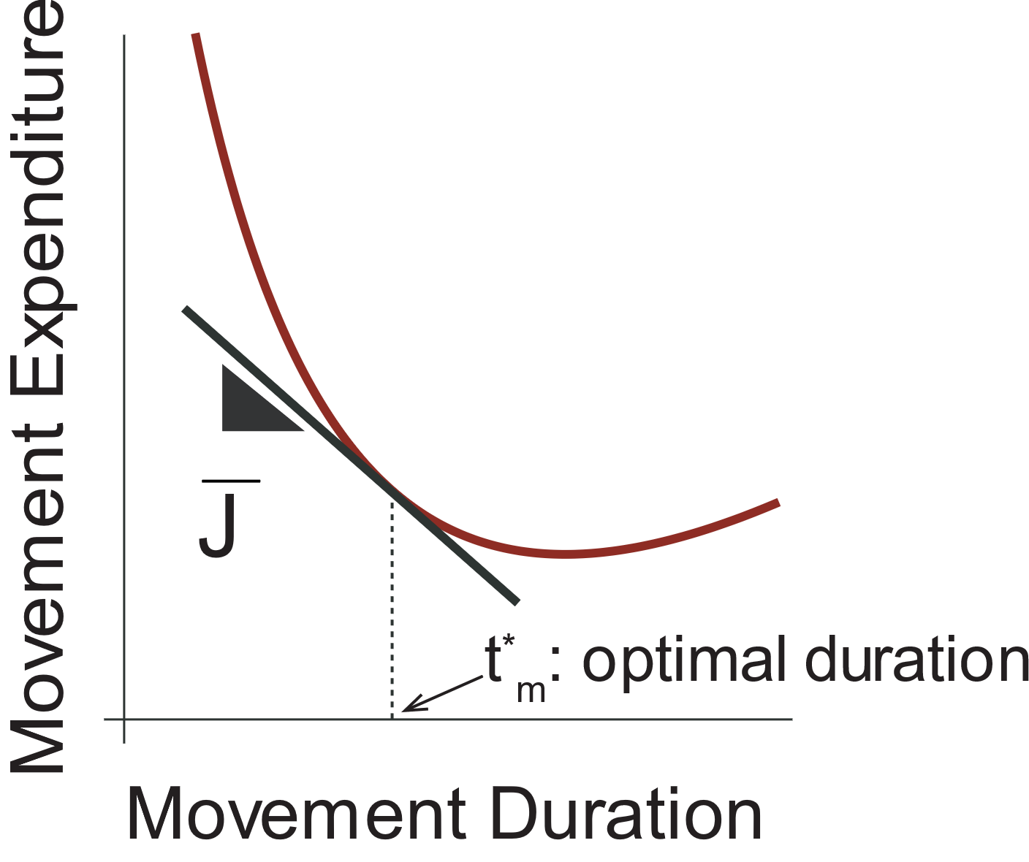
Generalized Mvt

Slide 16
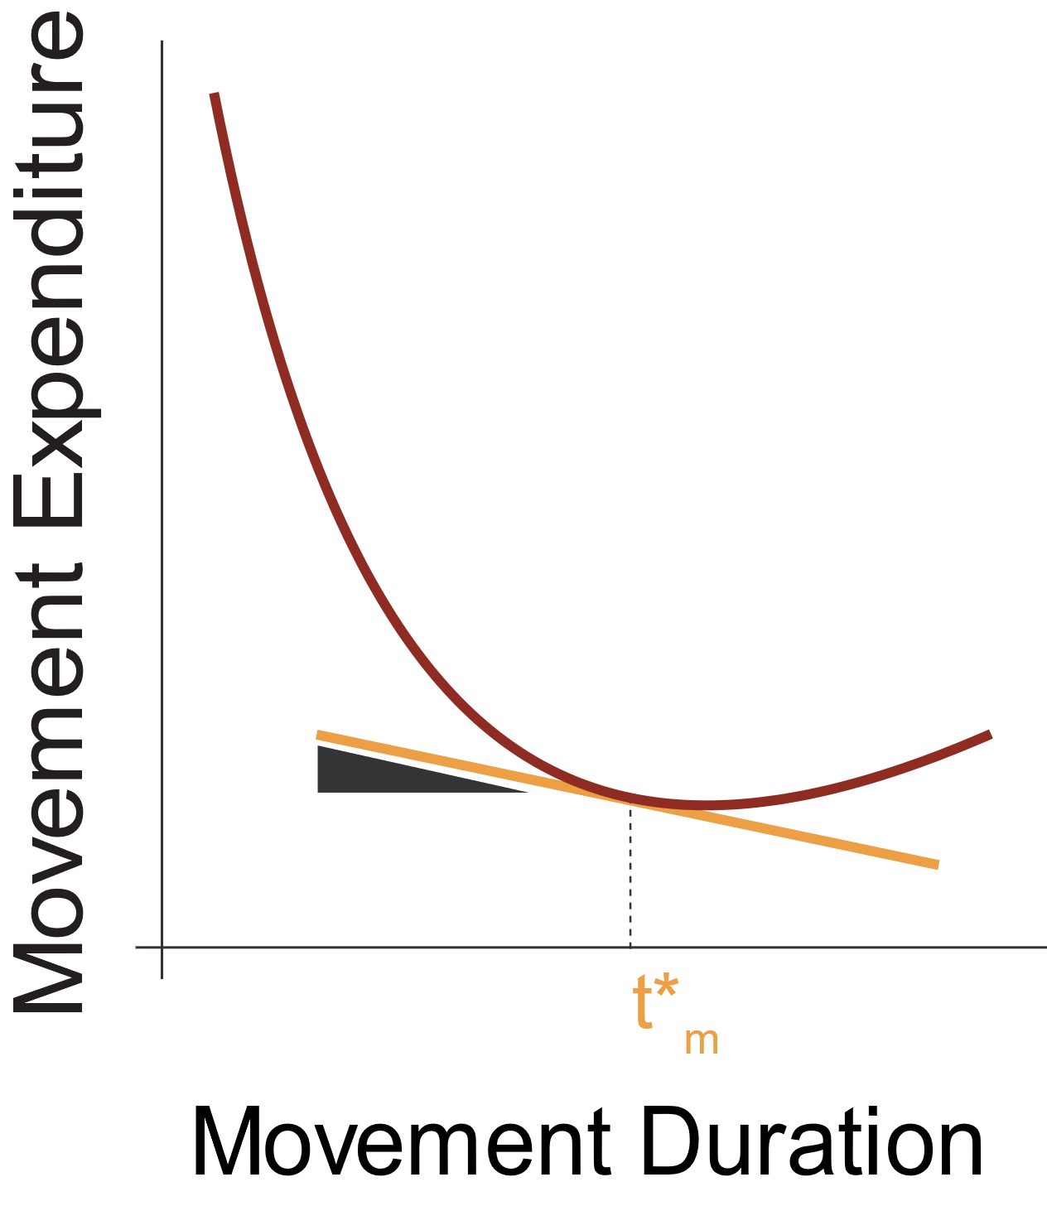
Corollaries and predictions

Slide 17
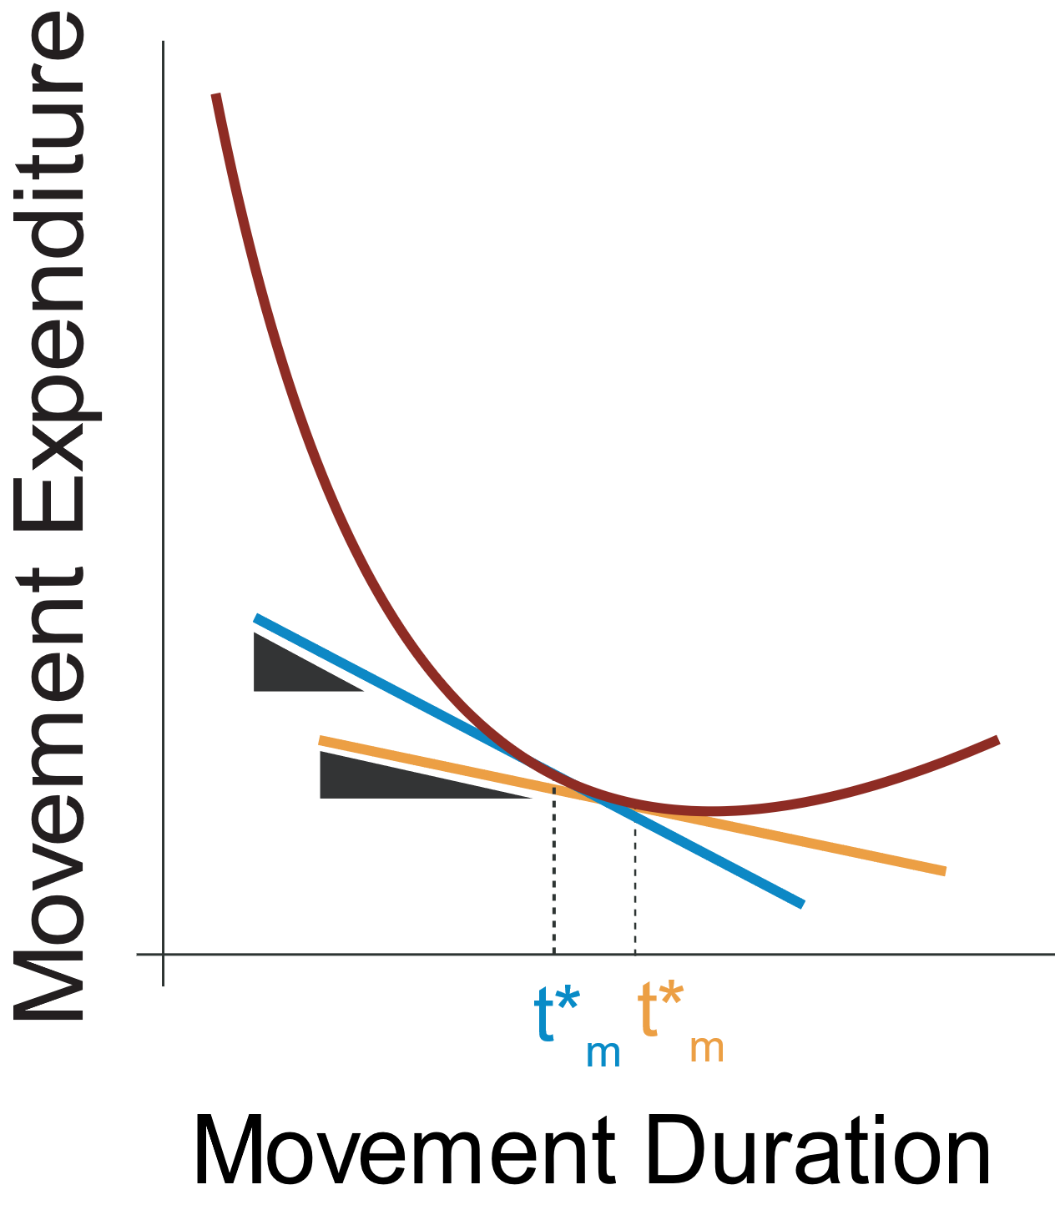
Corollaries and predictions

Slide 18
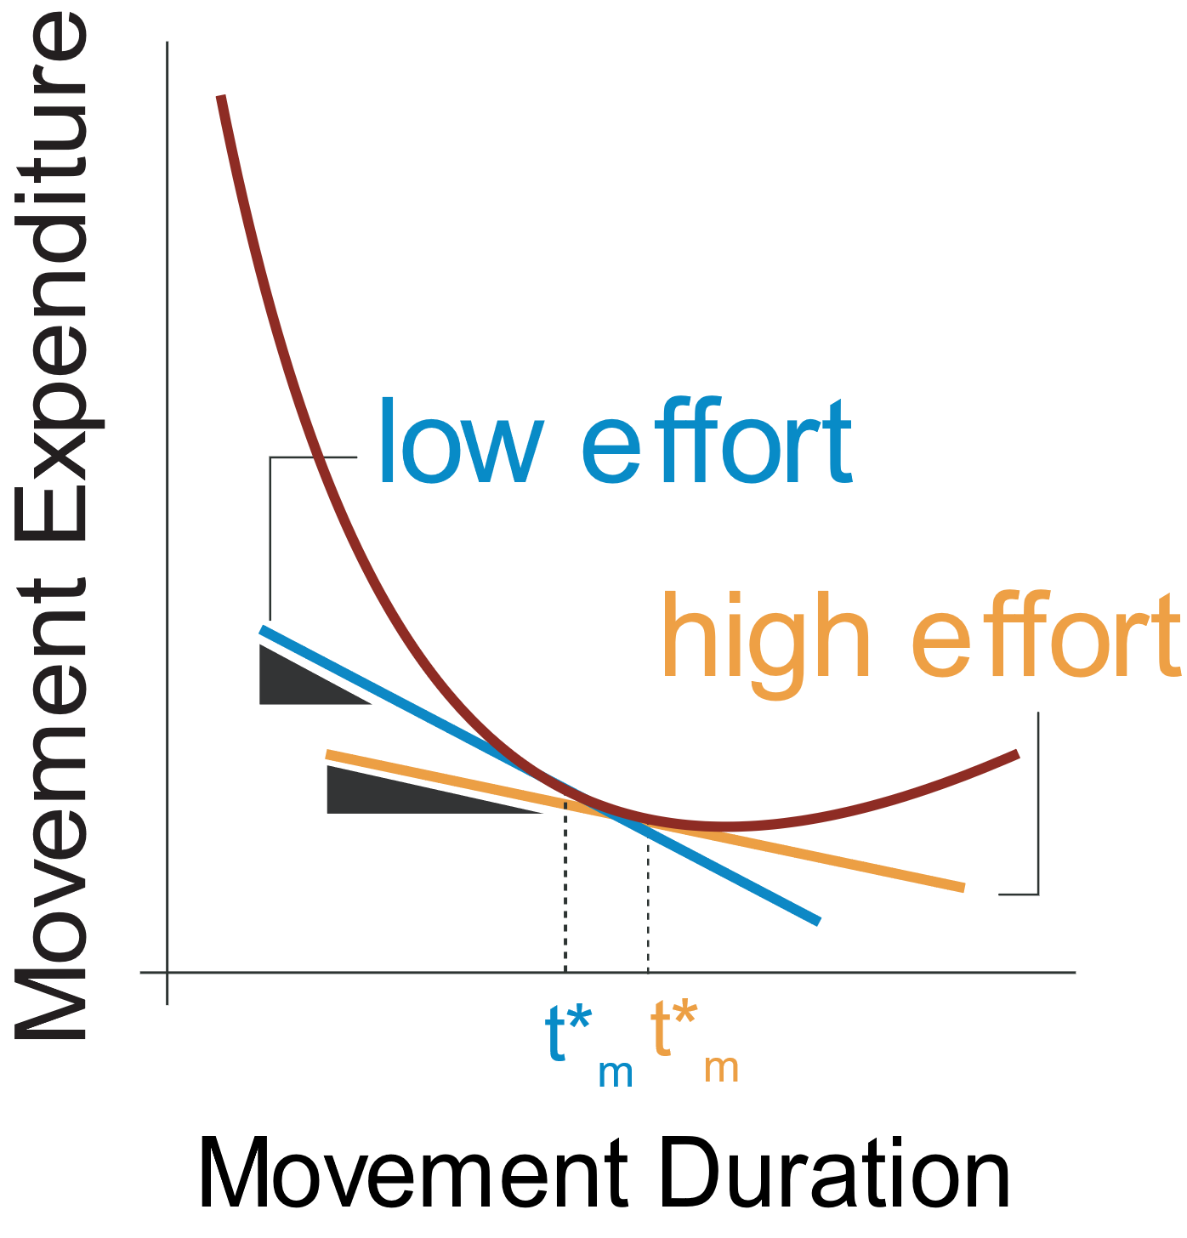
Corollaries and predictions

Slide 19
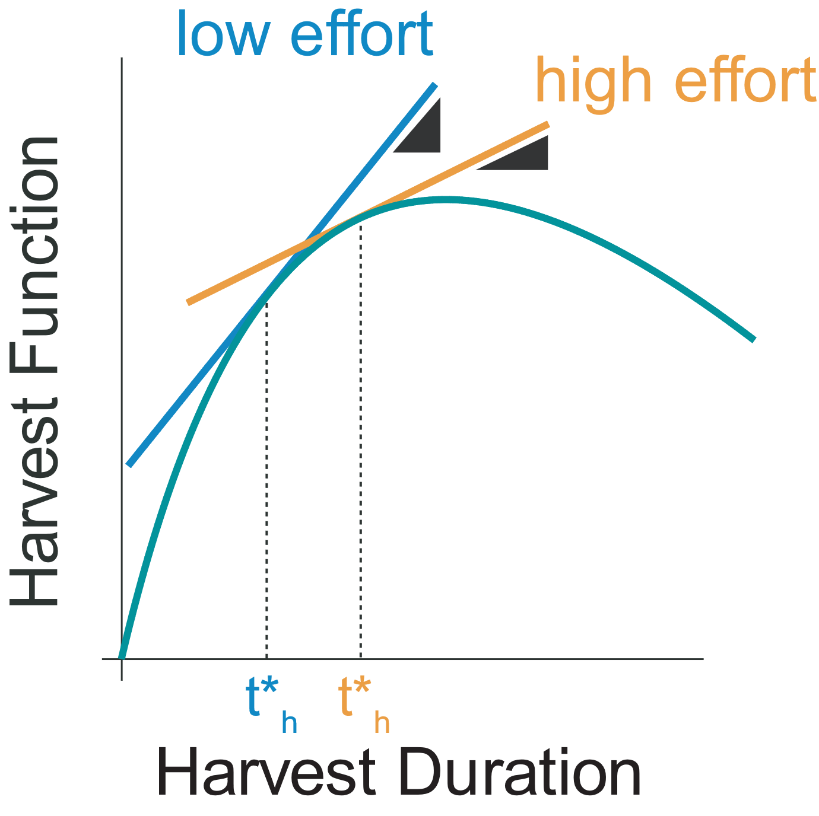
Corollaries and predictions

Slide 20
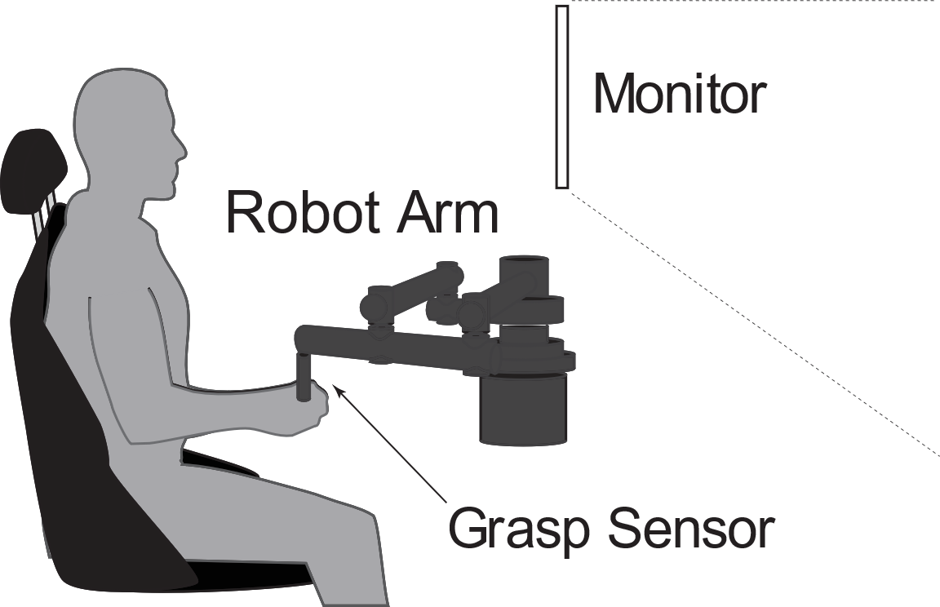
Foraging task

Slide 21
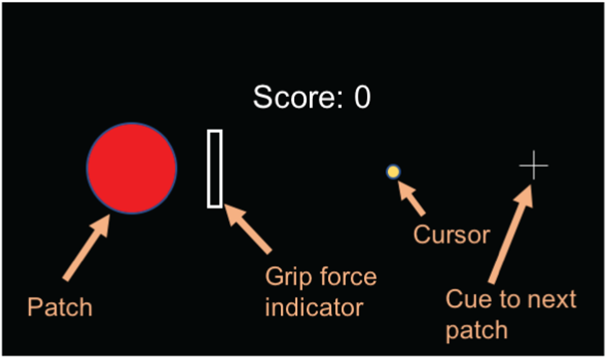
Foraging task

Slide 22
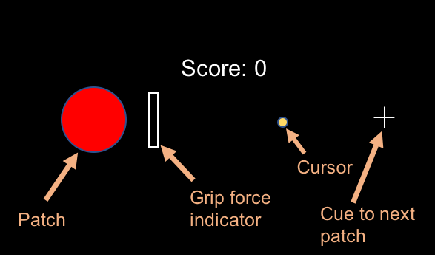
Foraging task

Slide 23
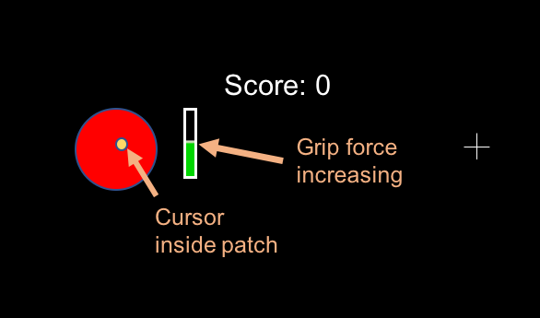
Foraging task

Slide 24
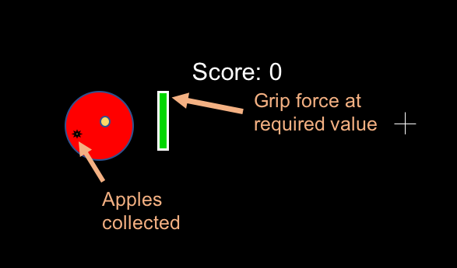
Foraging task

Slide 25
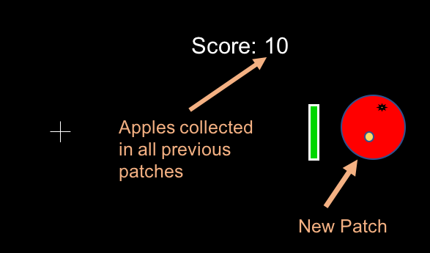
Foraging task

Slide 26
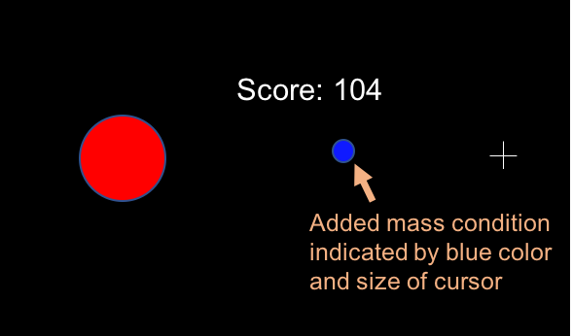
Foraging task

Slide 27
Protocol

Slide 28
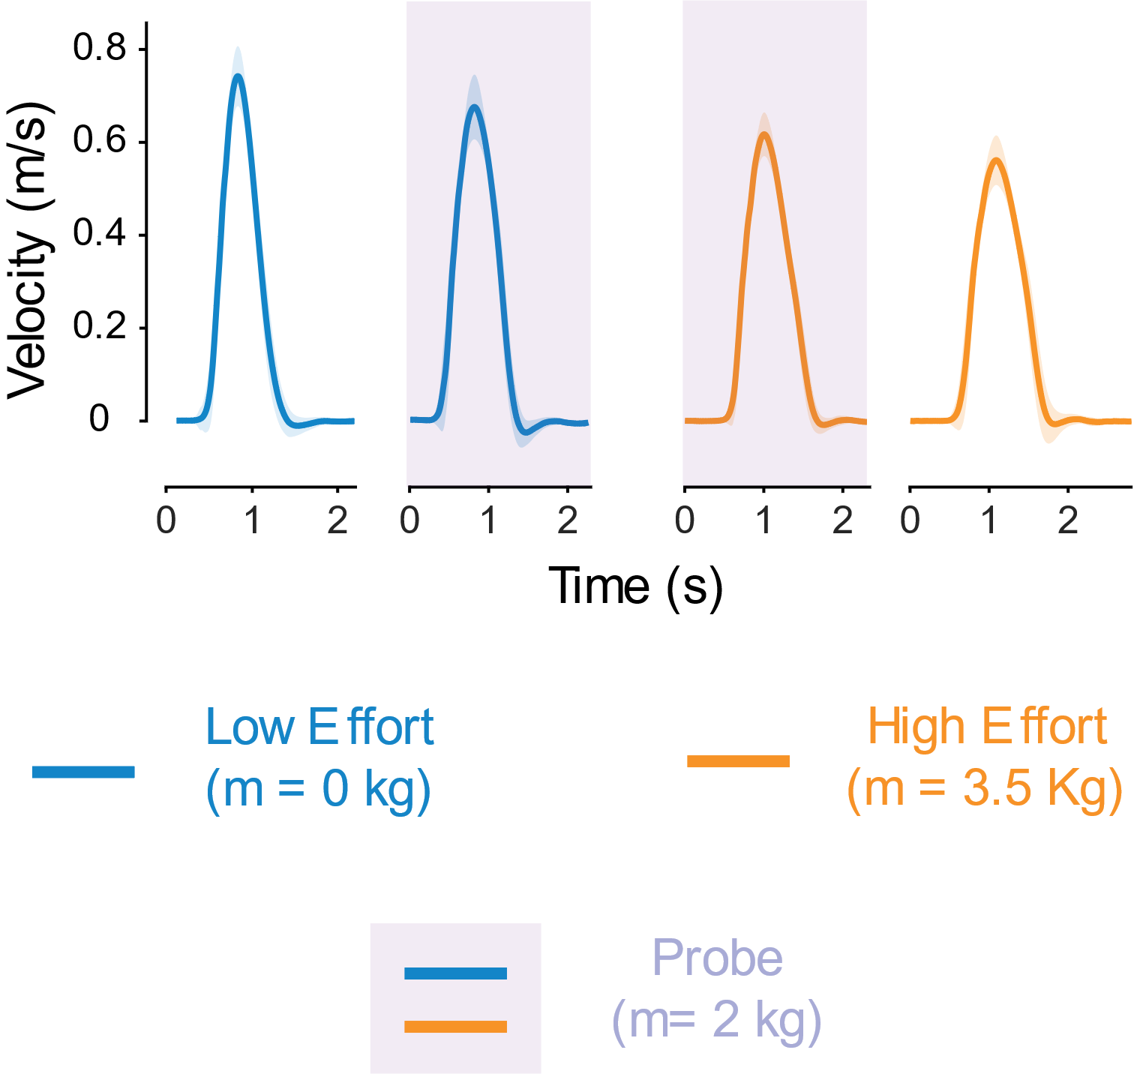
Effect of history on vigor – example subject

Slide 29
Metrics of vigor
Peak velocity
Travel Duration

Slide 30
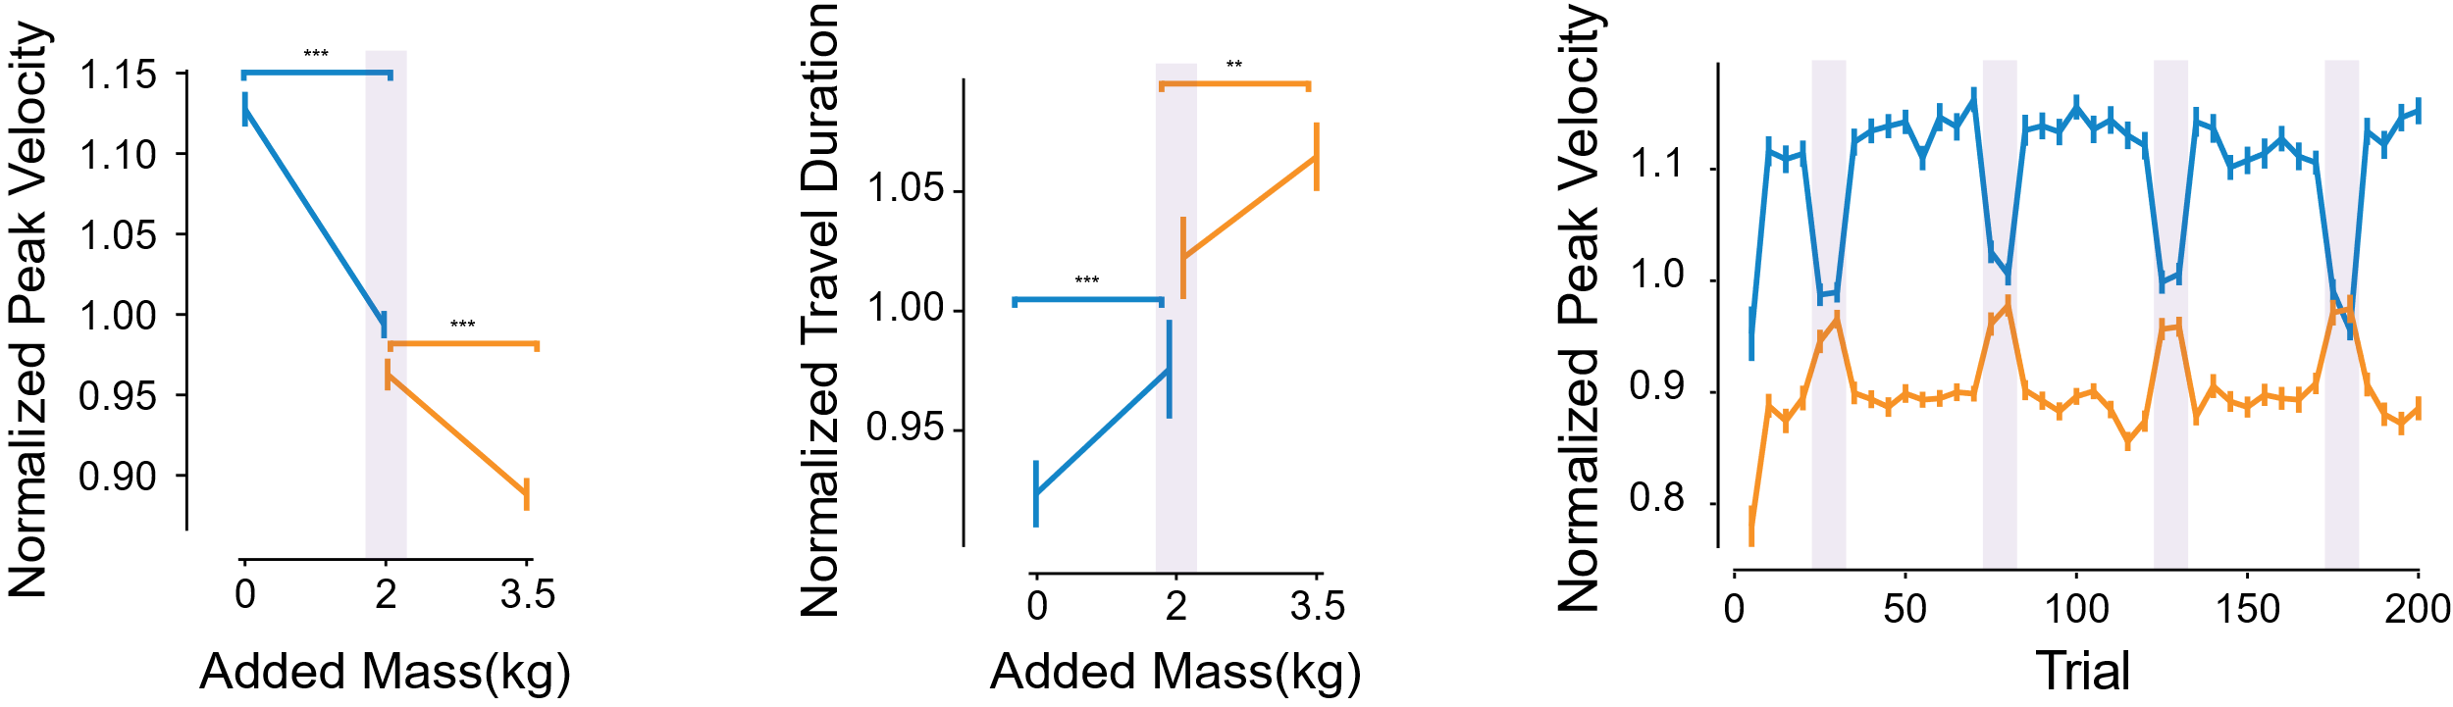
Subjects increase vigor after history of low effort

Slide 31
Subjects increase vigor after history of low effort

Slide 32
Subjects increase vigor after history of low effort

Slide 33
Subjects increase vigor after history of low effort

Slide 34
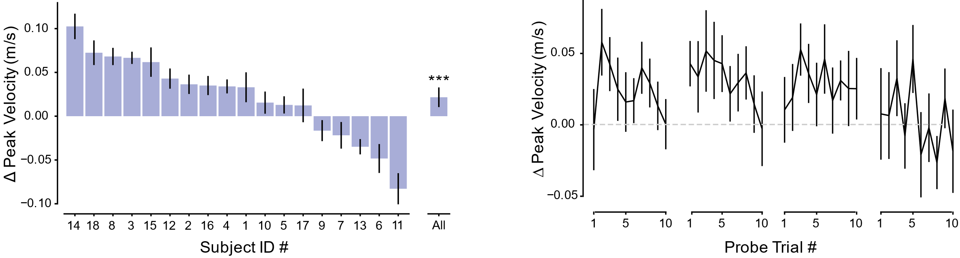
Subjects increase vigor after history of low effort

Slide 35
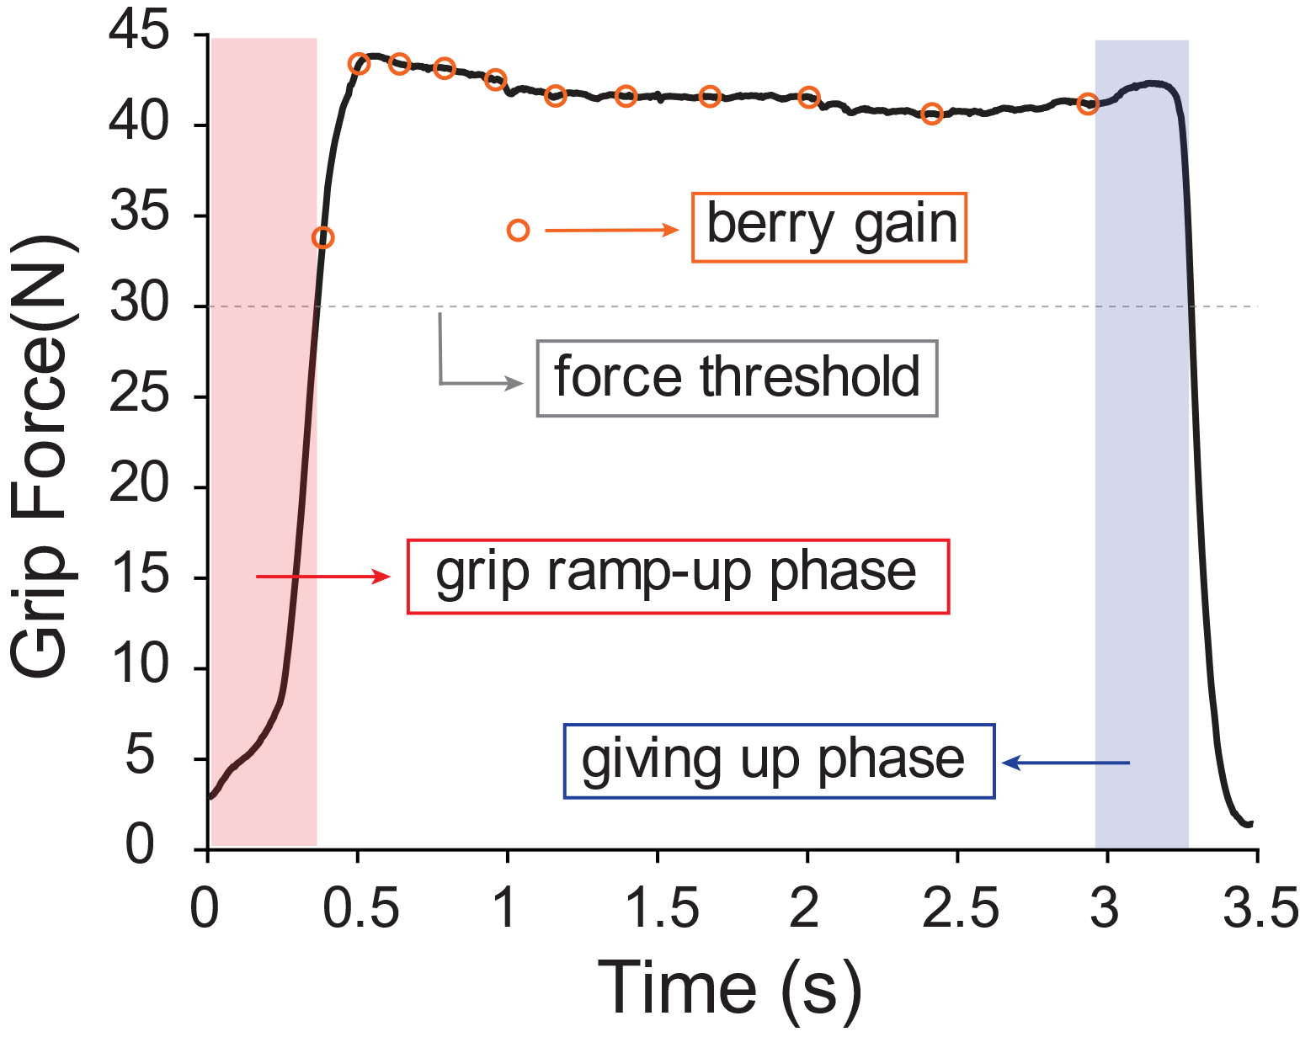
Harvest behaviour

Slide 36
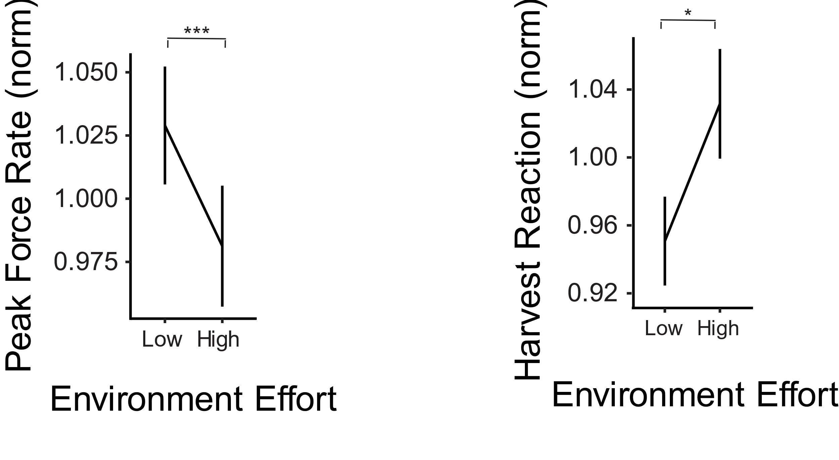
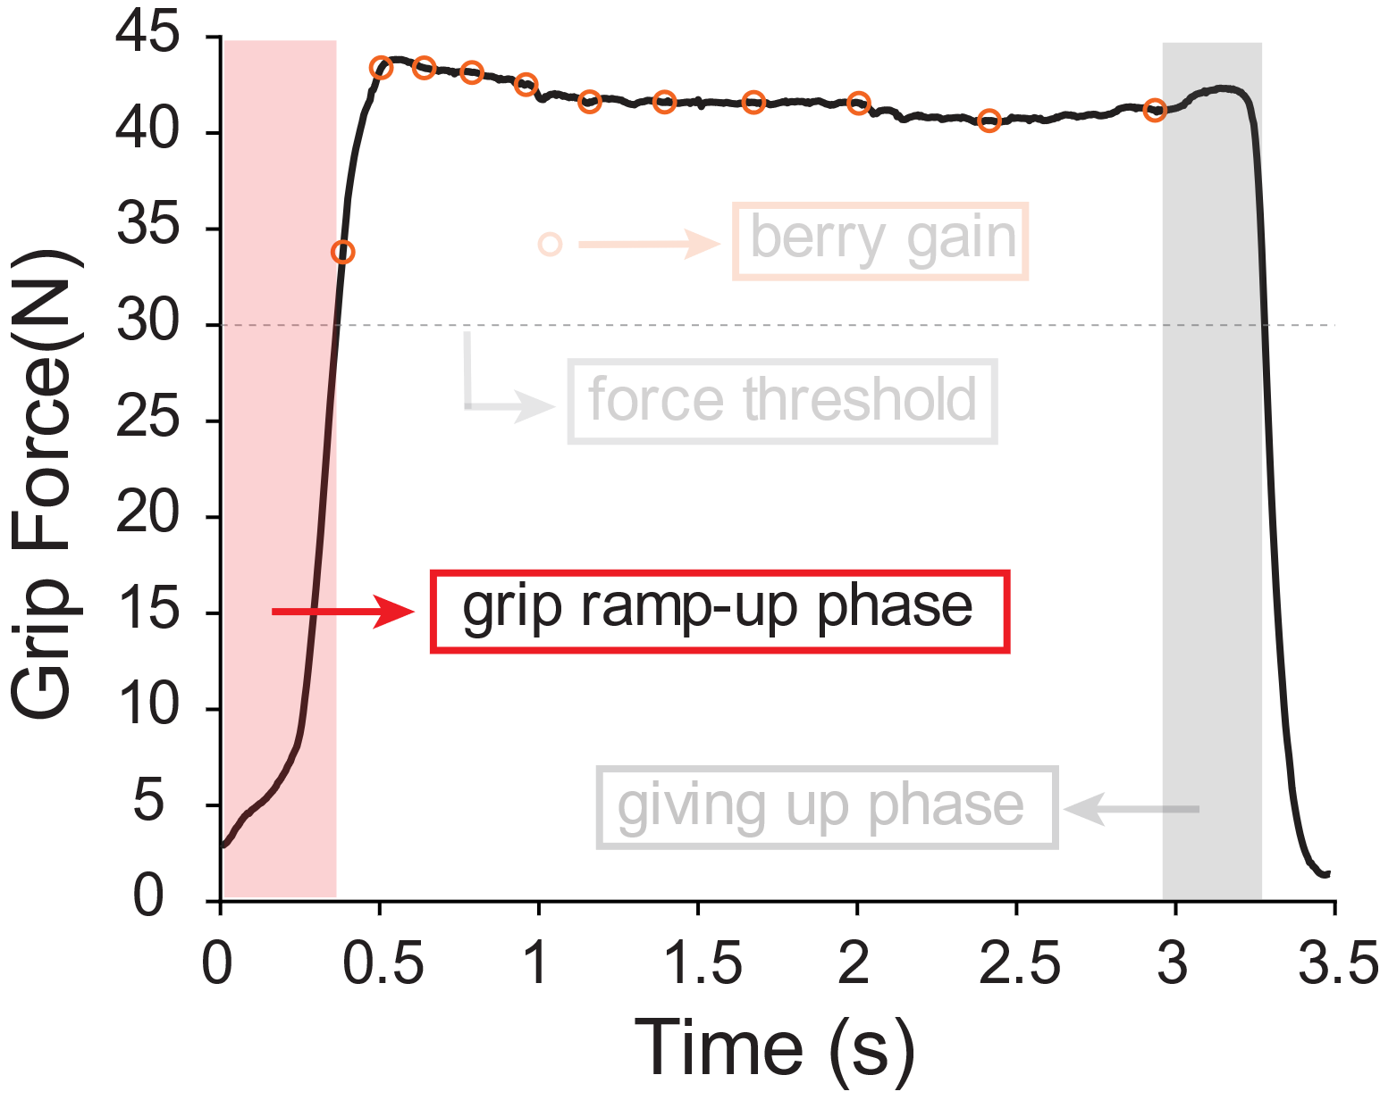
Subjects increase their grip ramp-up speed

Slide 37
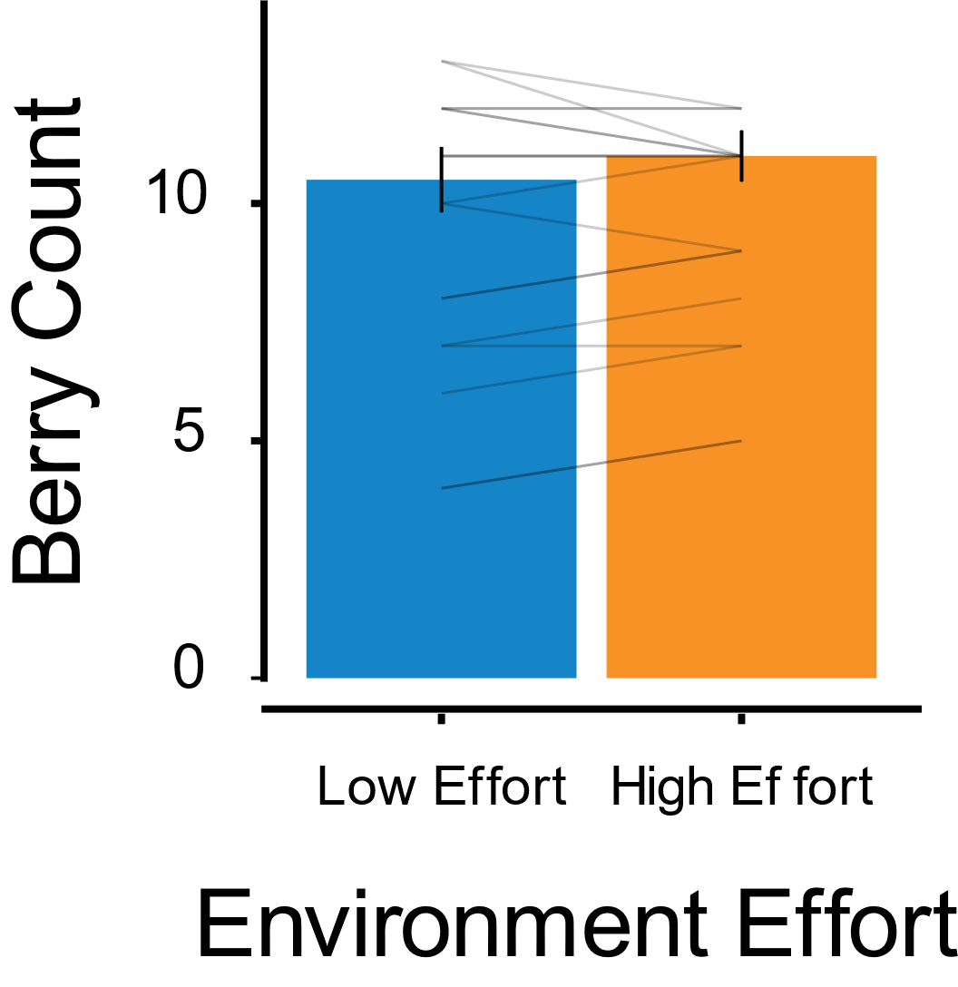
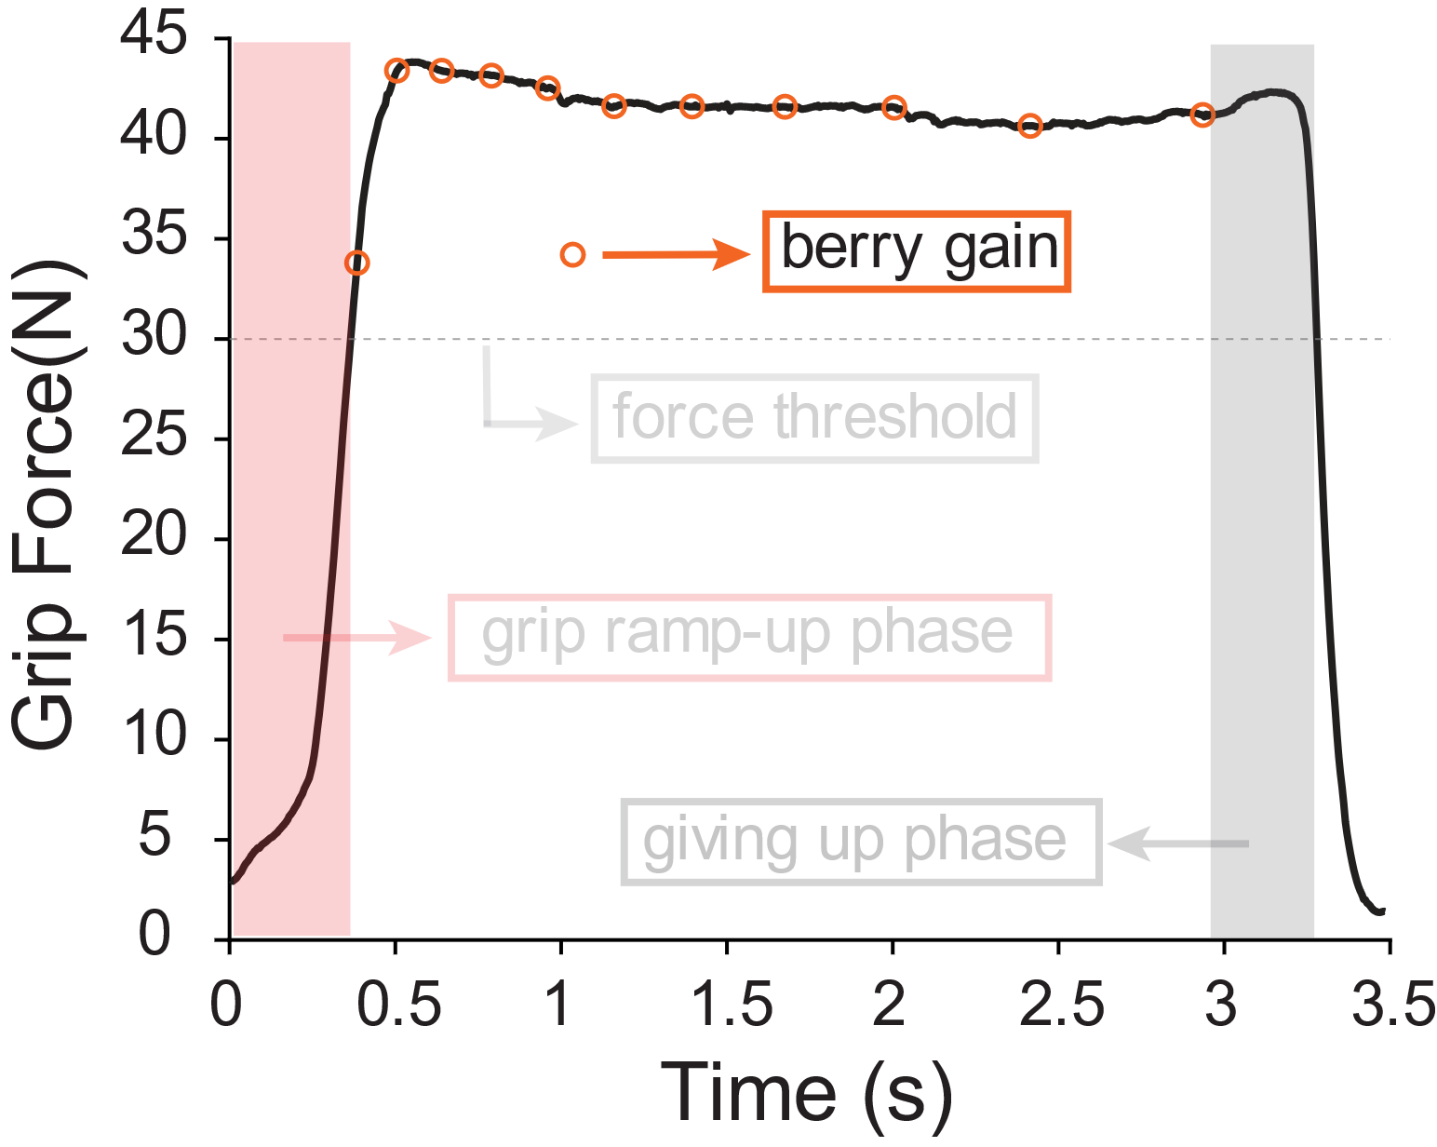
Harvest behaviour

Slide 38
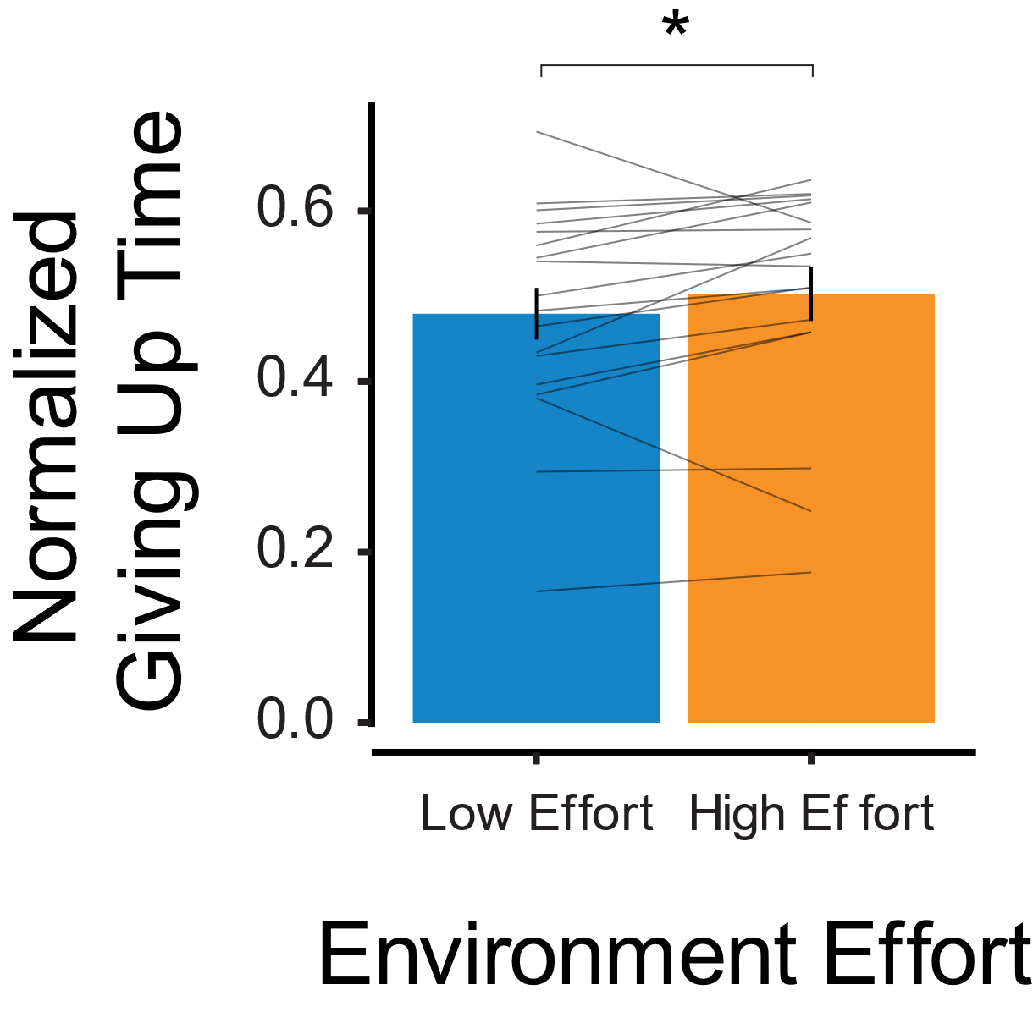
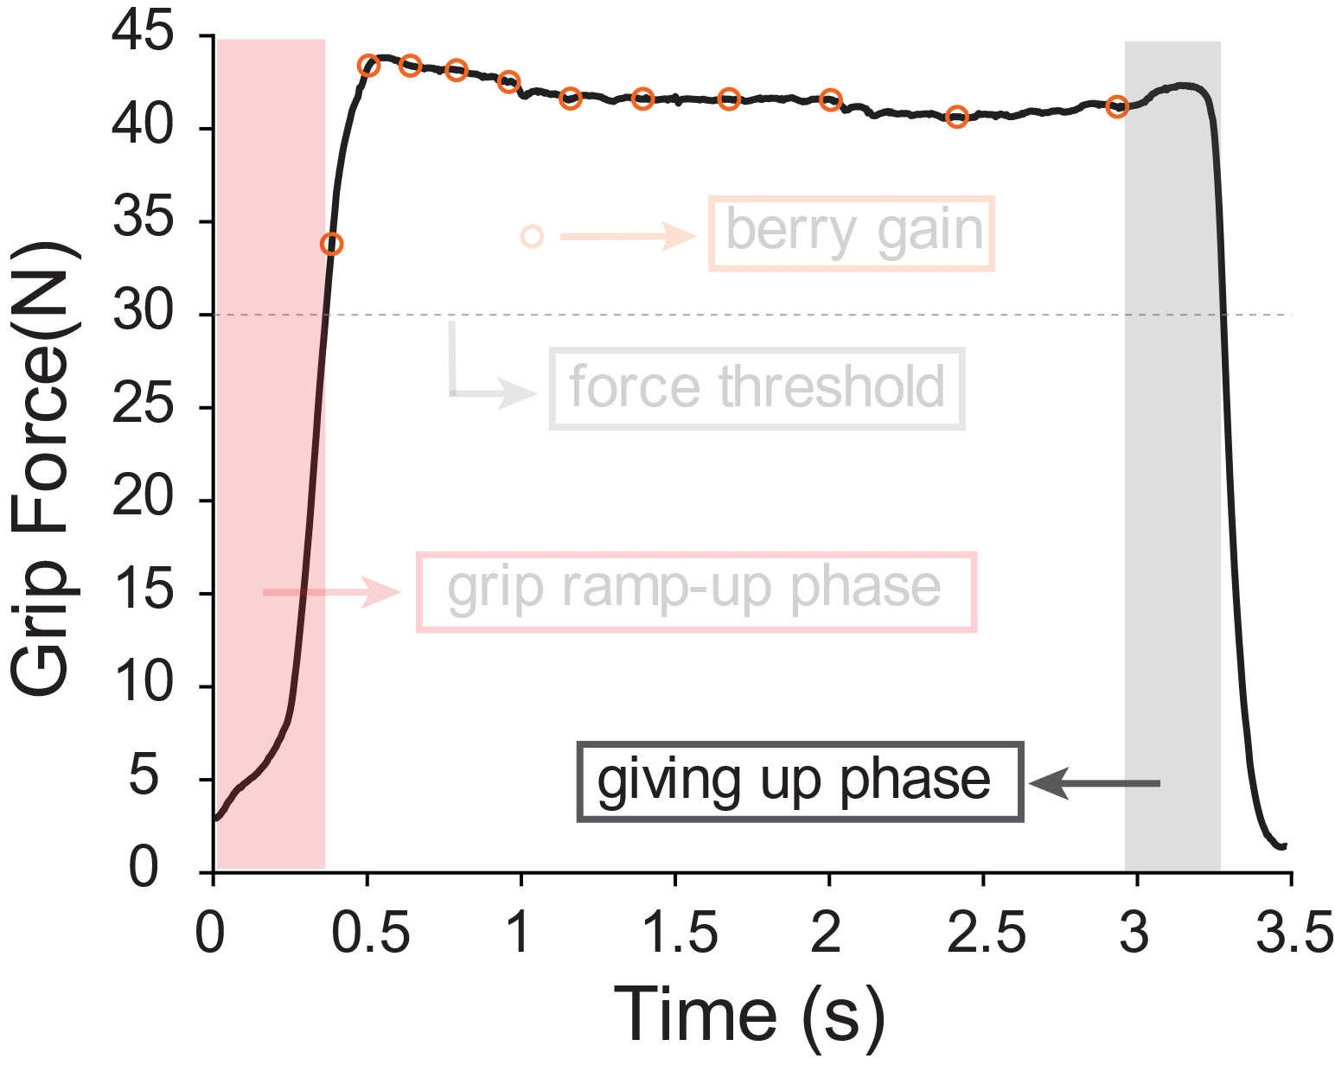
Harvest behaviour

Slide 39
In summary
Movement vigor was modulated by history: subjects increased their vigor after a history of low effort as compared to a history of high effort.
While the number of berries harvested was not significantly modulated by environment, subjects reduced their grip ramp-up duration and giving-up duration in the lower effort environment.

Slide 40
Future work
Effect of reward history on movement vigor.
Determining the cost of switching : exploration-vs-exploitation (w/ Colin)

